Slide 1
The Roaring Twenties
A Booming Economy

Slide 2
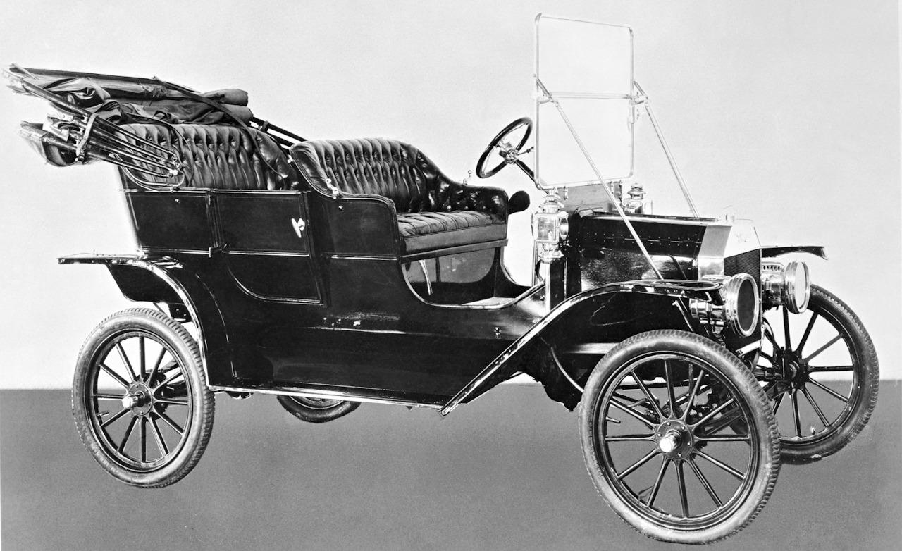
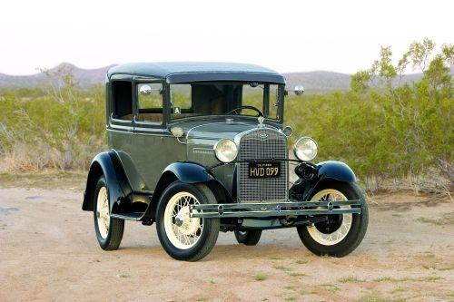
The Automobile Drives Prosperity
Henry Ford introduced a series of methods and ideas that revolutionized production, wages, working conditions and daily life
Mass production → the rapid manufacture of large numbers of identical products
In 1908, Ford produced his Model T which was a reliable automobile that could be purchased for $850
Scientific management → relatively new method of improving efficiency in the workplace
Implementation of the assembly line dropped the price as low as $290 by 1927

Slide 3
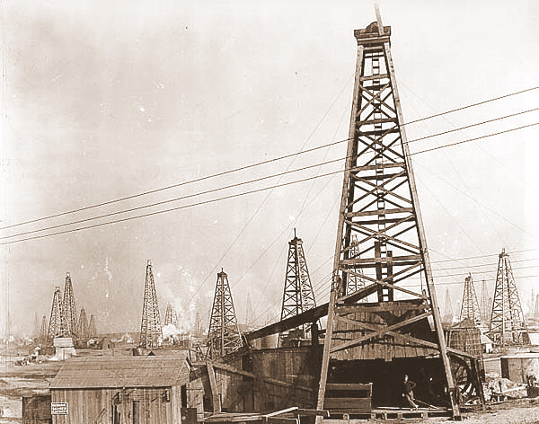
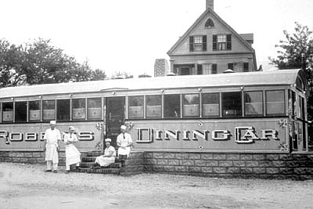
Automobile Changes America
The boom in the automobile industry promoted growth in other industries related to cars (oil, rubber, asphalt, steel, gasoline, glass, etc)
Oil discoveries in California, Texas, Oklahoma, and New Mexico brought workers and money to the region
Road construction grew, especially when the federal government introduced the system of numbered highways in 1926
Growth in highways led to growth in roadside diners, motor hotels (motels), and service stations
The automobile allowed people to live further away from their place of employment, allowing for the development of suburban communities

Slide 4
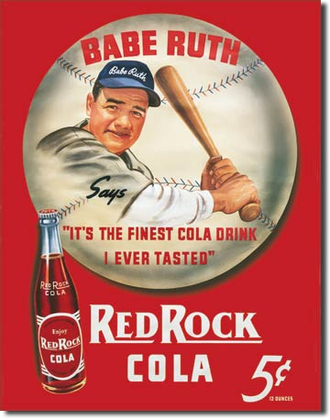
Advertising and Credit
Consumer Revolution → introduction of new, affordable goods that became widely available to the public
Companies began to implement new “scientific” techniques and psychological research to sell more products to consumers
Magazine and newspaper ads focused on the desires, wants, and fears of the American public
Developed a desire to have a “name brand” product
Installment buying → consumer would make a small down payment and then ay off the rest of the debt in regular monthly payments

Slide 5
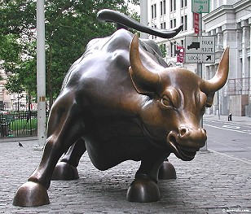
Bull Market Means Big Fortunes
The stock market was experiencing a bull market, which is a period of rising stock prices
More and more Americans invested in stocks in an attempt to get rich quick
By 1929, around 4 million Americans owned stocks
Buying on margin → a form of buying stock on credit which involved a buyer paying little down to a broker and repaying as their stock increased

Slide 6
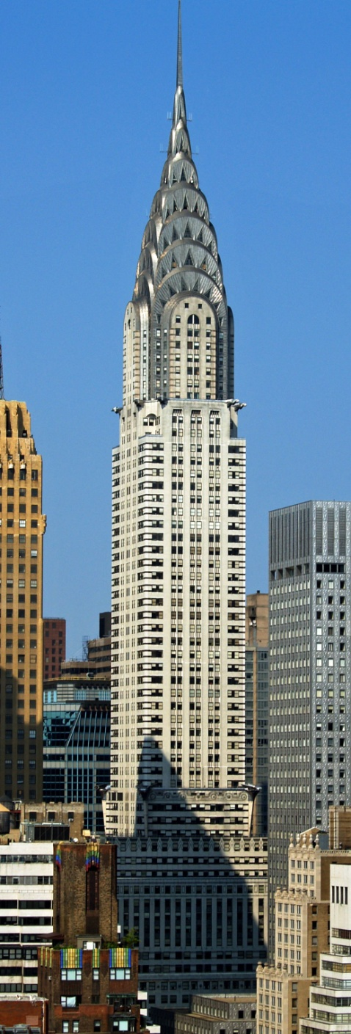
Urbanization
In the 1920s, people moved back towards the cities
Most new immigrants are settling in major industrial cities
Farmers, who were not prospering in the 1920s, will move into the cities for better job opportunities
African Americans, during the Great Migration, continue to move from the agricultural South to the urban North
Skyscrapers, including the Empire State Building and the Chrysler Building, will began to define the skyline

Slide 7
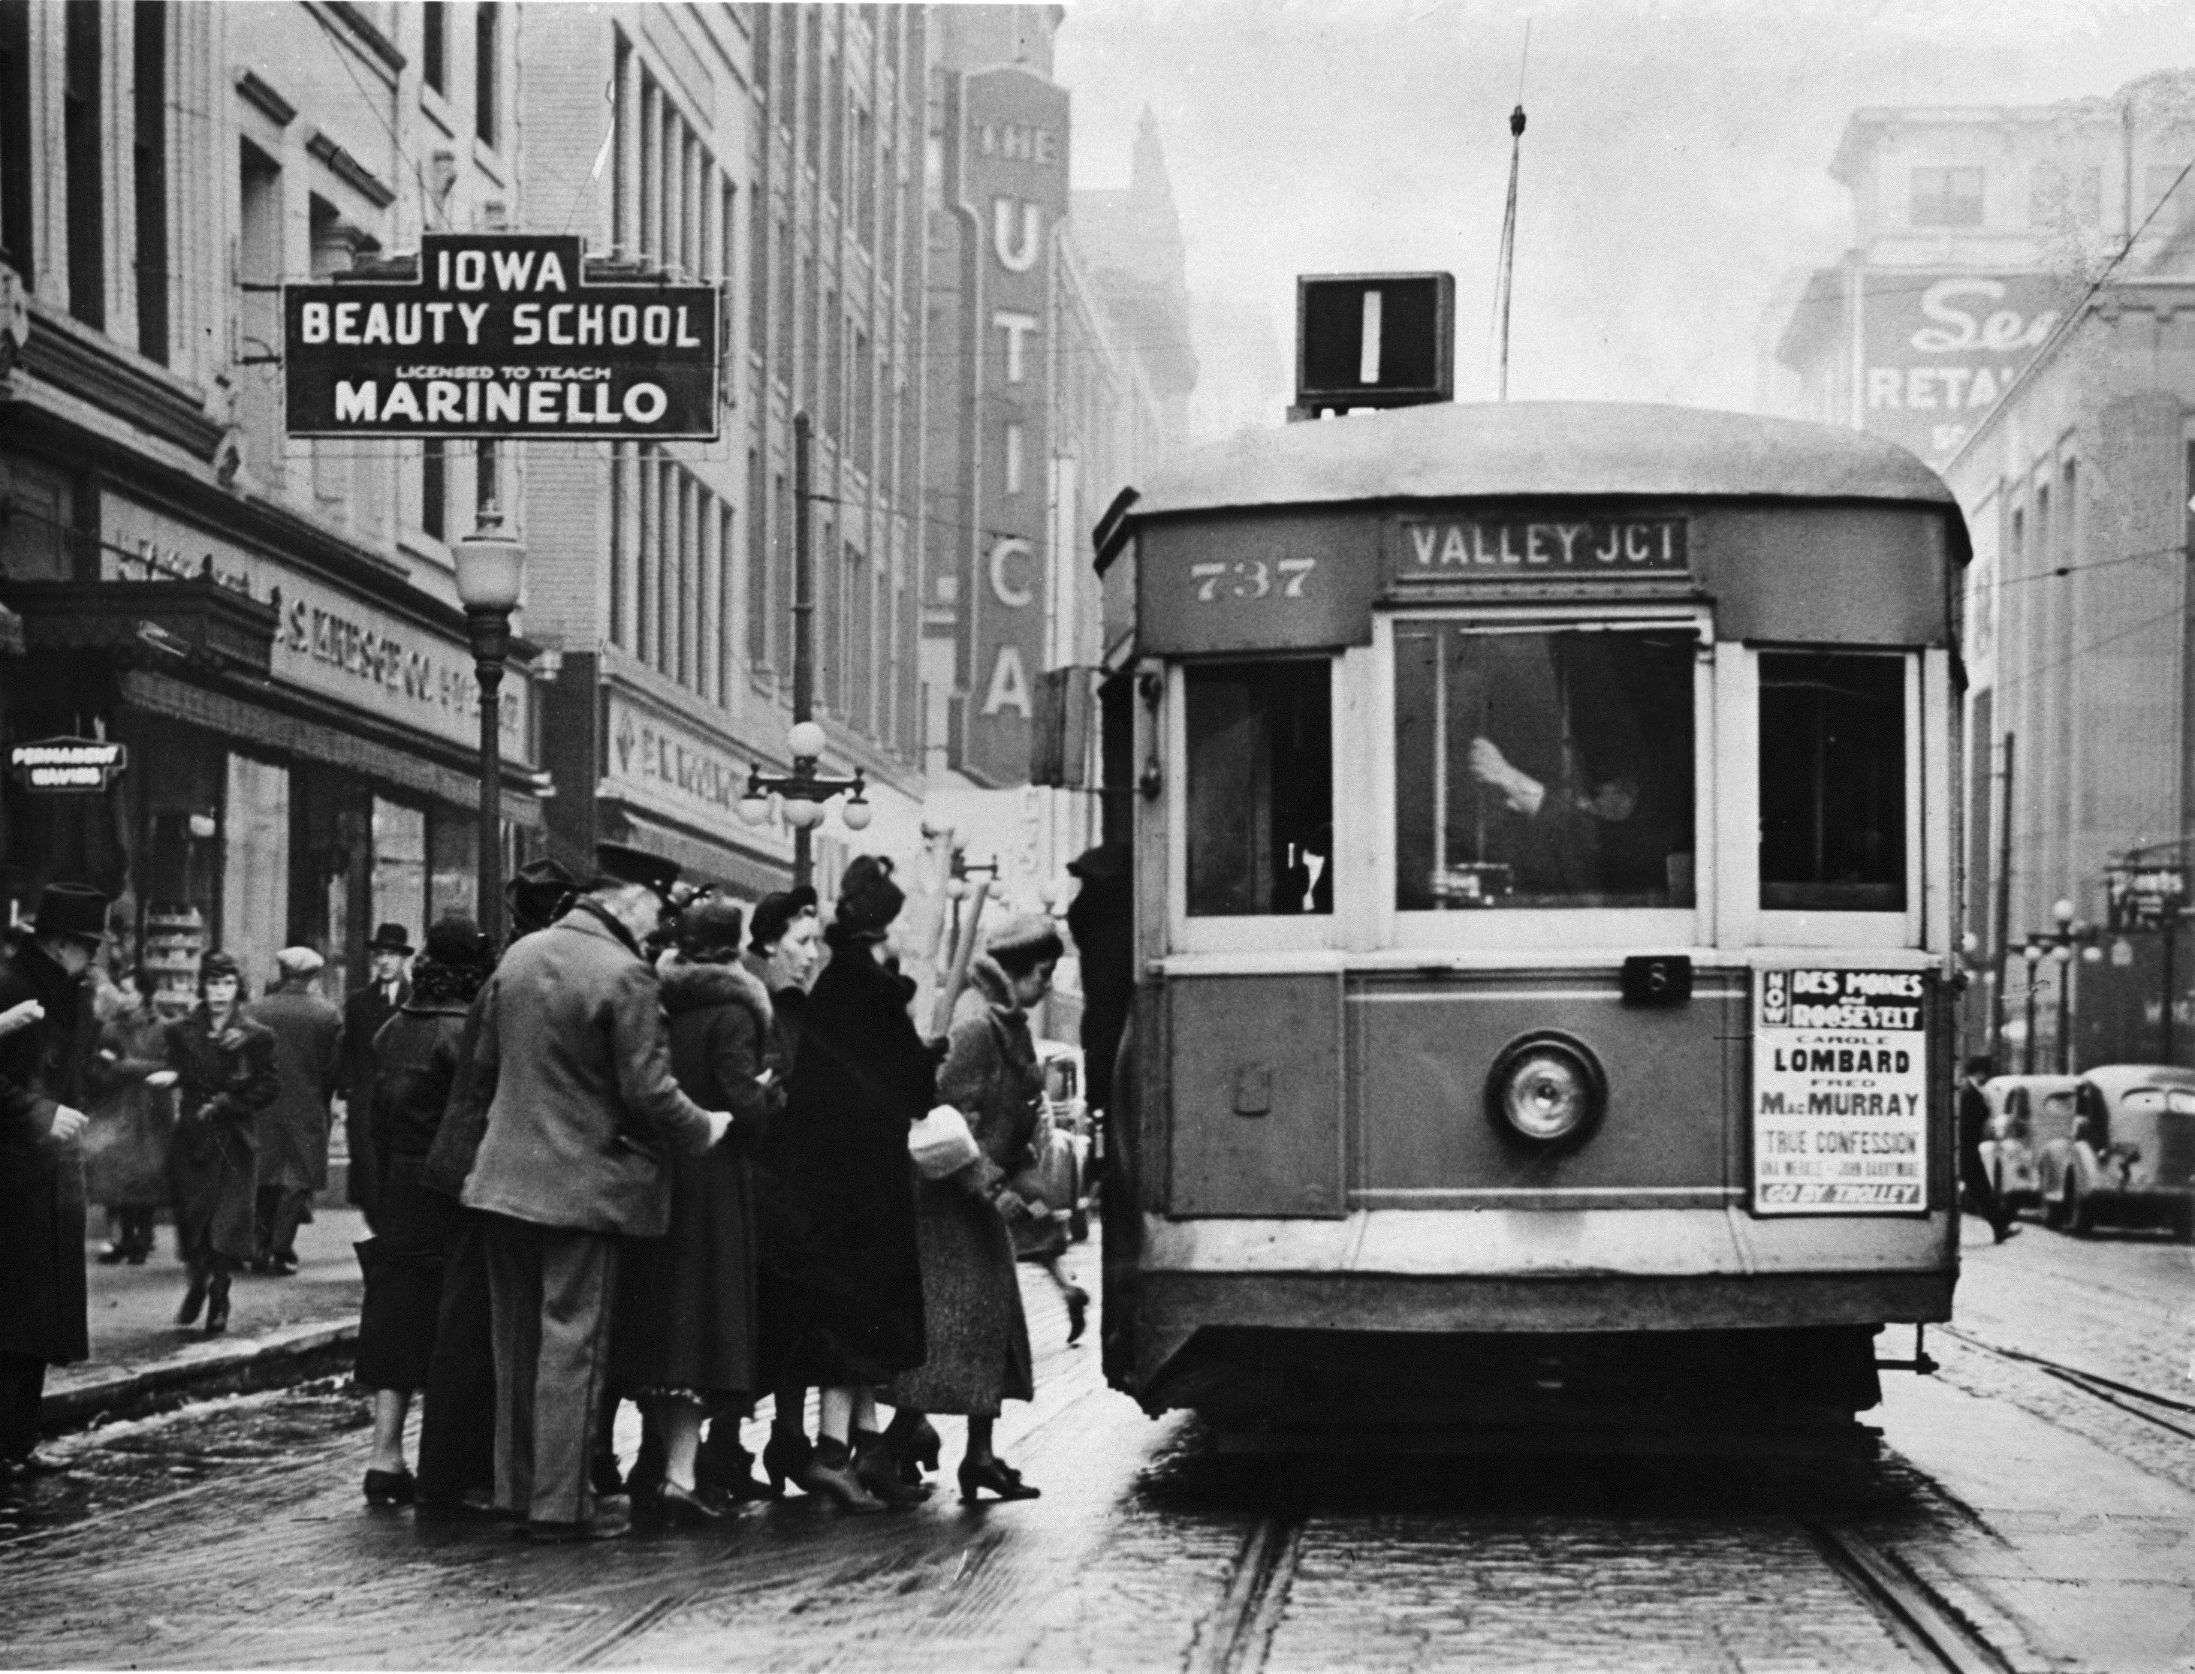
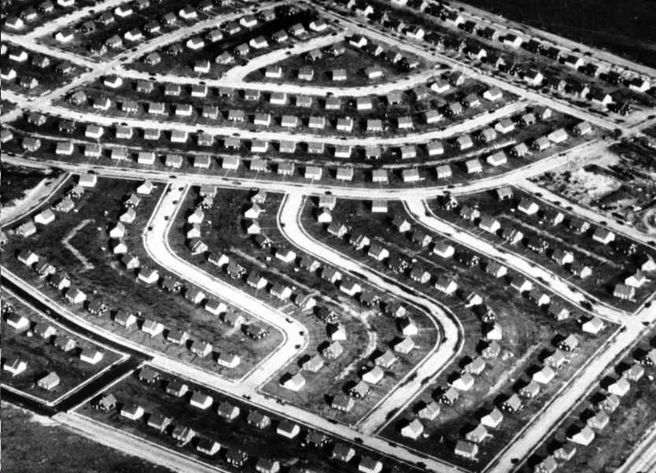
Growing Suburbs
Improved mass transportation, such as the streetcar, and widespread use of the automobile caused cities to expand their borders
Many urban workers will settle in the more affordable suburbs
Suburbs tended to cater to middle and upper class residents and eventually developed into conservative, and often republican, areas

Slide 8
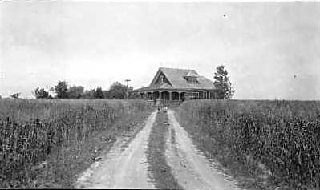
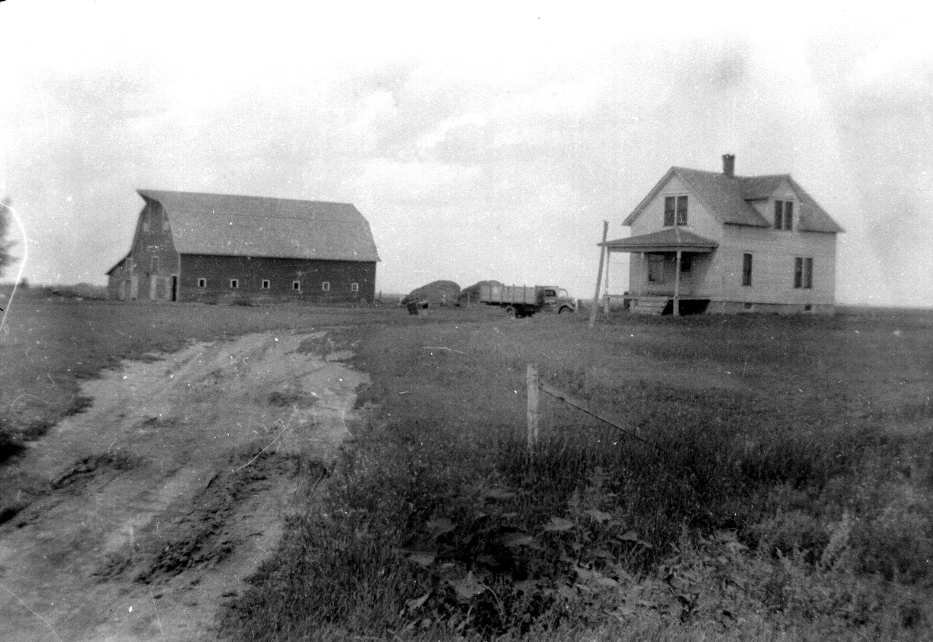
Hardships in the Country
Farm incomes will steadily decline following World War I
Most people living in the country did not participate in the consumer benefits and economic gains of the cities and suburbs
Some industrial workers in the inner cities will continue to struggle with low wages and harsh conditions

