Slide 1
The Business of Government
The Harding and Coolidge Administrations

Slide 2
The Harding Administration

Slide 3
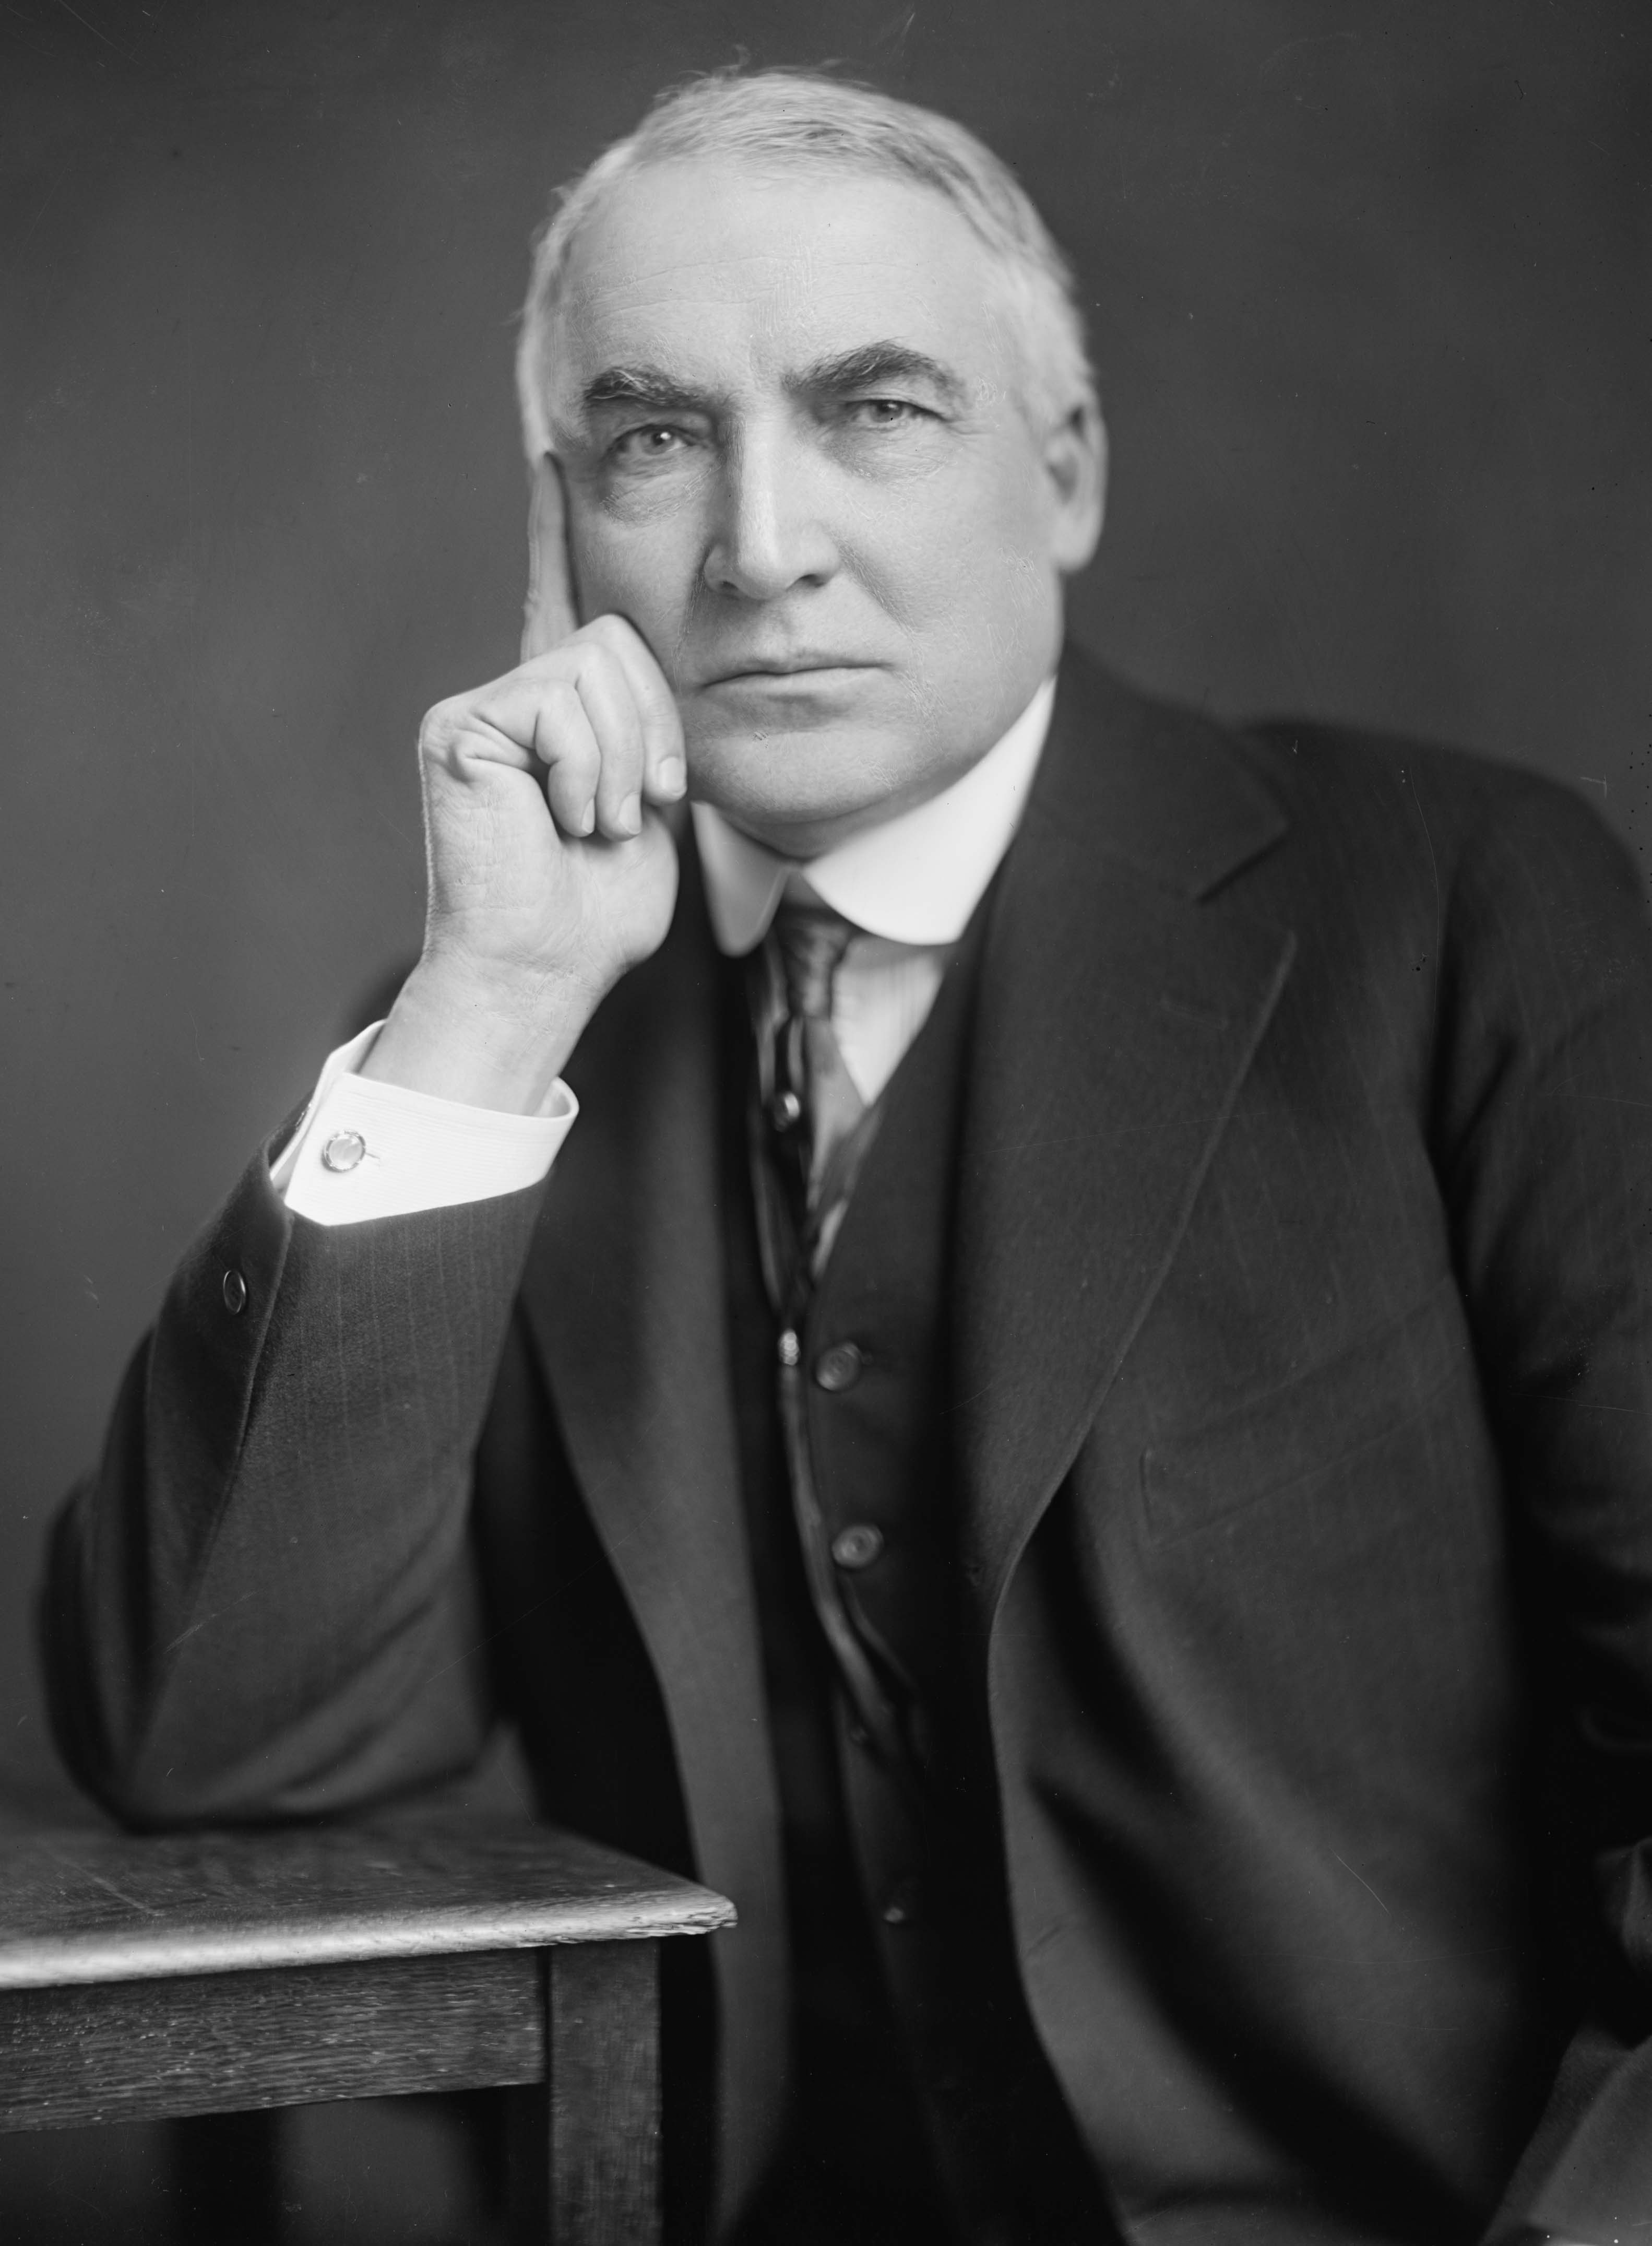
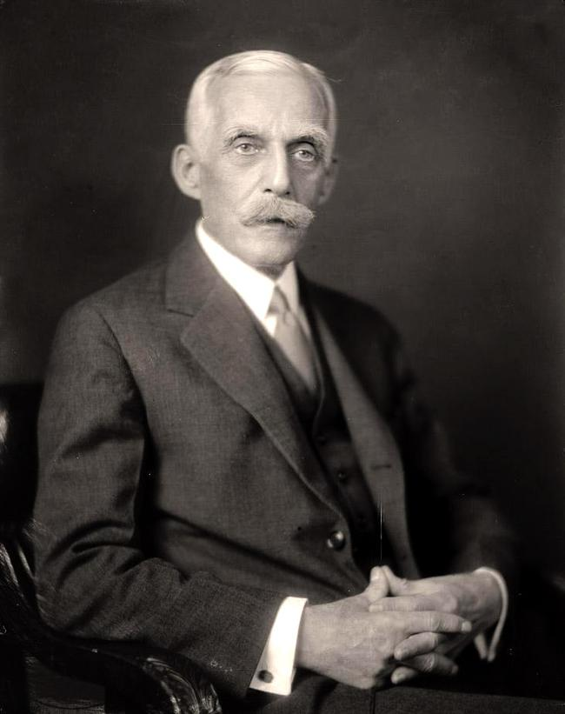
New Policies Favor Big Business
Harding named wealthy banker Andrew Mellon as the Secretary of the Treasury
Mellon supported legislation that advanced business interests
He disliked the new income tax and instead favored low taxes on individuals and corporations
By 1925, Congress reduced spending from $18 billion to $3 billion
Harding introduced a protective tariff increase of 25%, which lead to other nations raising their tariffs as well
Harding’s Secretary of Commerce, Herbert Hoover, worked with business and labor leaders to achieve voluntary advancements

Slide 4
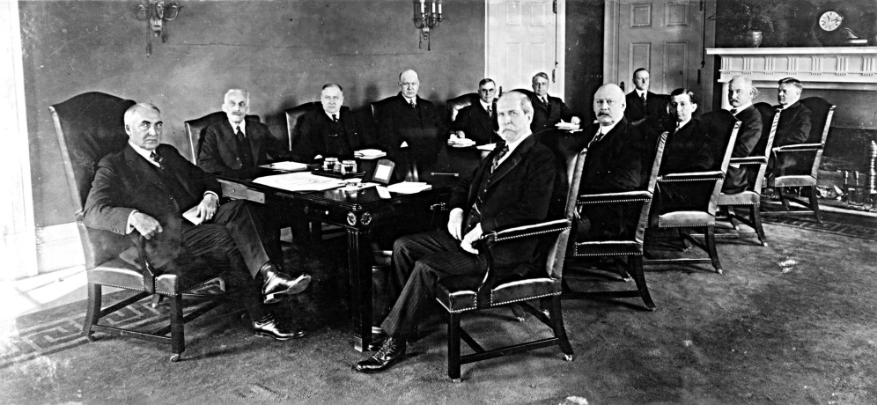
“The Ohio Gang”
Harding was a kind, likable man, but he was not considered to be particularly intelligent
Harding relied on others to complete many of the necessary tasks of the president
He hired men from his hometown that he enjoyed spending time with often
These men were known as the “Ohio gang”
They were not honest politicians and used their positions to gain personal wealth at the expense of the government

Slide 5
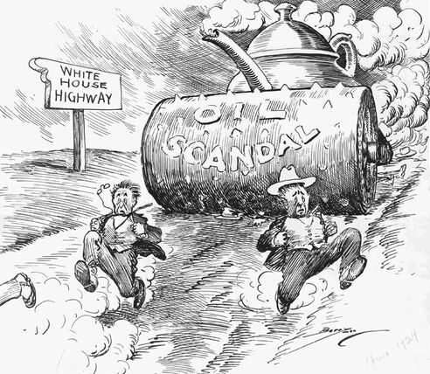
Teapot Dome Scandal
In 1921, Secretary of the Interior Albert Fall arranged to transfer oil reserves in Elk Hills, California and Teapot Dome, Wyoming from the Navy Department to the Interior Department
He then leased the properties to private oilmen in return for “loans” – which were actually bribes
Rumors of the misdeeds led to a Senate investigation and eventually the whole scandal was revealed to the American public in 1924
The oil reserves were returned to the government and Fall was sentenced to a year in jail

Slide 6
The Coolidge Administration

Slide 7
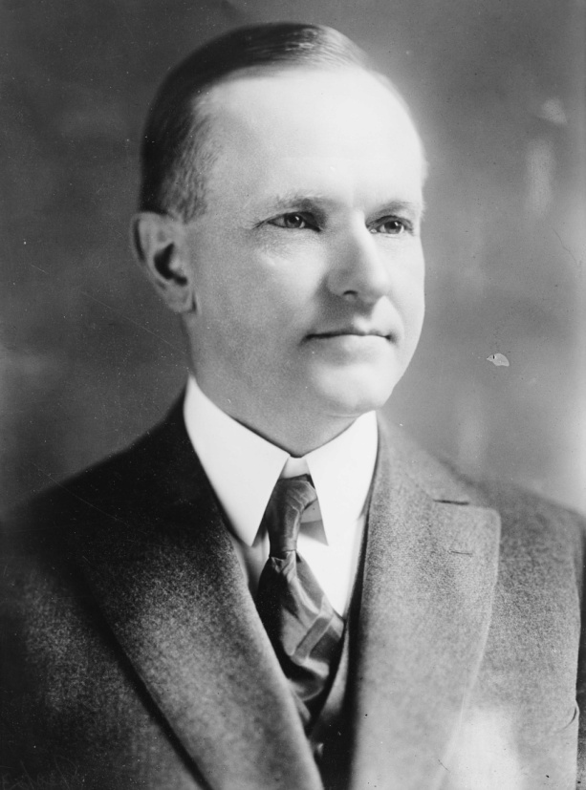
Silent Cal
On August 2, 1923, returning from a speaking tour in Alaska, Harding suffered a heart attack and died
Calvin Coolidge, as the Vice President, was then sworn in as president
Very different from the outgoing Harding, Coolidge, often known as “Silent Cal” was quiet, honest, and frugal
He placed his administration in the hands of men who held to the simple virtues of an older America

Slide 8
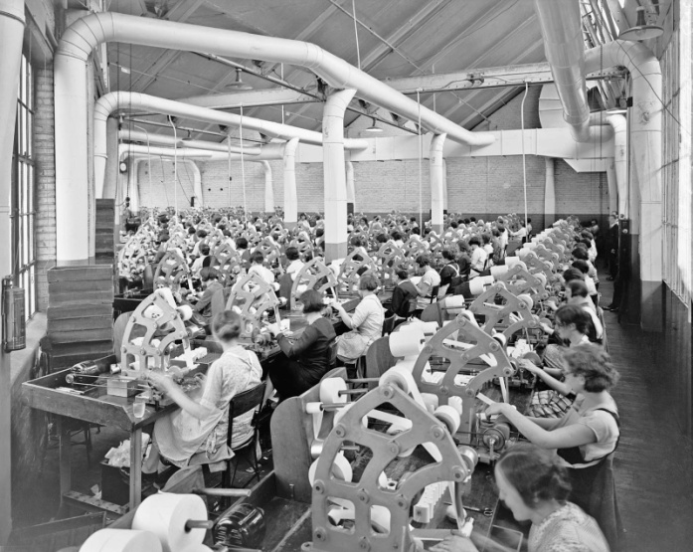
Continued Support of Big Business
Coolidge admired men who were productive business leaders
Coolidge stated that “the chief business of the American people is business.”
He continued to follow the goals of Secretary of the Treasury Mellon by reducing the national debt, trimming excess spending, and lowering taxes for businesses

Slide 9
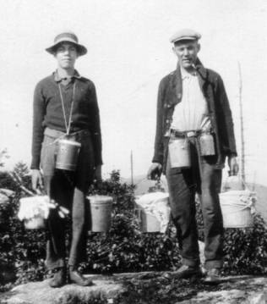
The Growth of Troubles
Farmers were struggling to keep their land as the prices of crops and goods fell
Labor unions demanded higher wages and better working conditions
African Americans faced severe discrimination, especially in the South

Slide 10
Seeking an End to War
 | Goal | U.S. Action
League of Nations (1919) | To prevent war and settle disputes between nations | U.S. membership was favored by Wilson; rejected by the Senate
World Court (1919) | To make judgments in international disputes voluntarily submitted by nations | U.S. participation favored by Harding; rejected by the Senate
Washington Naval Conference (1921) | To reduce arms race and size of navies | U.S. agreed with leading naval powers to limit construction of warships
Kellogg-Briand Pact (1928) | To “outlaw war… as an instrument of national policy” | U.S. agreed with many nations to renounce war as a means of settling international disputes

Slide 11
Collecting War Debts
The United States insisted that France and Britain repay their huge war debts
For this to occur, Germany needed to begin making its reparations imposed by the Treaty of Versailles
Because this system of reparations and debt repayments threatened to collapse the fragile international economy many statesmen advised to forgive the debts
Coolidge believed that a debt was a debt and must be repaid
Dawes Plan → arranged US loans to Germany so that they could start making reparations to France and Britain
Due to the Stock Market Crash of 1929 the US money backing this plan dried up and the plan fell apart

