Slide 1
Culture of the 1930s

Slide 2
Cinema & Escapism
Film companies, such as MGM, Warner Brothers, Twentieth Century Fox, and Paramount, dominated the movie industry
In 1939, nearly 2/3 of Americans attended at least one movie a week
People went to the movies to seek relief from their daily concerns through escapism
Popular depression era films include The Wizard of Oz, Gone with the Wind, Snow White and the Seven Dwarfs, and Top Hat

Slide 3
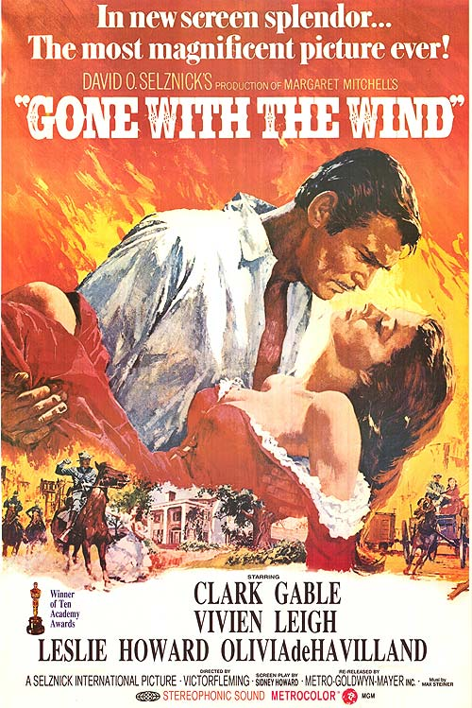
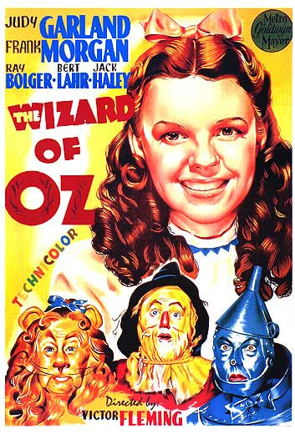

Slide 4
Social Commentary
Many films of the era also provide a social commentary of the public’s distrust of big business and government
These films include Public Enemy, starring James Cagney
However, do to the renewed trust stemming from the New Deal, films began to provide an improved view of the government, Like Mr. Smith Goes to Washington

Slide 5
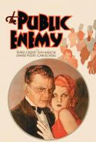
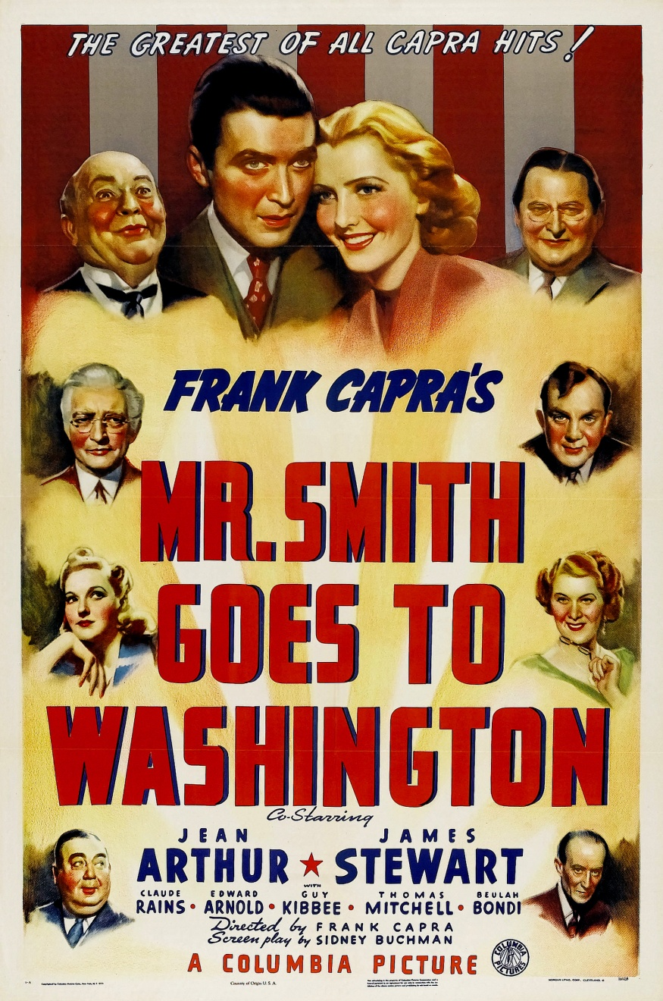

Slide 6
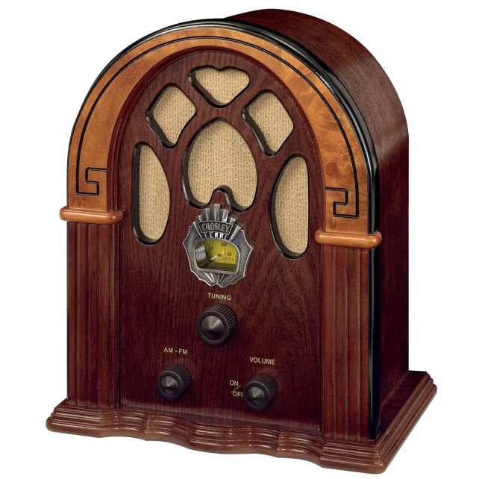
Radio’s Golden Age
By 1935, two in three homes owned a radio; by 1940, nine in ten did
Nation radio networks broadcasted shows featuring comedians like Bob Hope and Jack Benny
Americans also enjoyed soap operas, variety shows, and humorists, like Will Rogers
Dramatic shows, like the Lone Ranger and the Shadow, thrilled many audiences
On one famous occasion in 1938, audiences had a hard time discerning reality from fiction when they believed that Orson Welles narration of the War of the Worlds was really happening

Slide 7
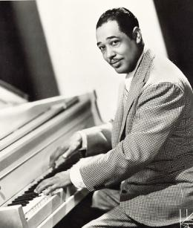
Sounds of the Era
Americans enjoyed popular music of the era at home on the radio and in nightclubs
Swing music played by big bands proved the most popular
Musicians like Duke Ellington, Benny Goodman, Artie Shaw, Glenn Miller, and Tommy Dorsey topped the charts
Latin music also gained in popularity
Black singers focused on the harsh conditions of the era

Slide 8
The New Deal and the Arts
Programs like the Federal Art Project, Federal Writers’ Project, and the Federal Theater Project offered a variety of job opportunities to artists
These programs funded theaters, allowed musicians and artists to stage performances, gave writers jobs recording the history and folklore of the nation, and funded artists to create murals on public buildings
Photographers, like Dorothea Lange, created powerful images that captured the difficulties of the time, like impoverished farmers and migrant workers

Slide 9
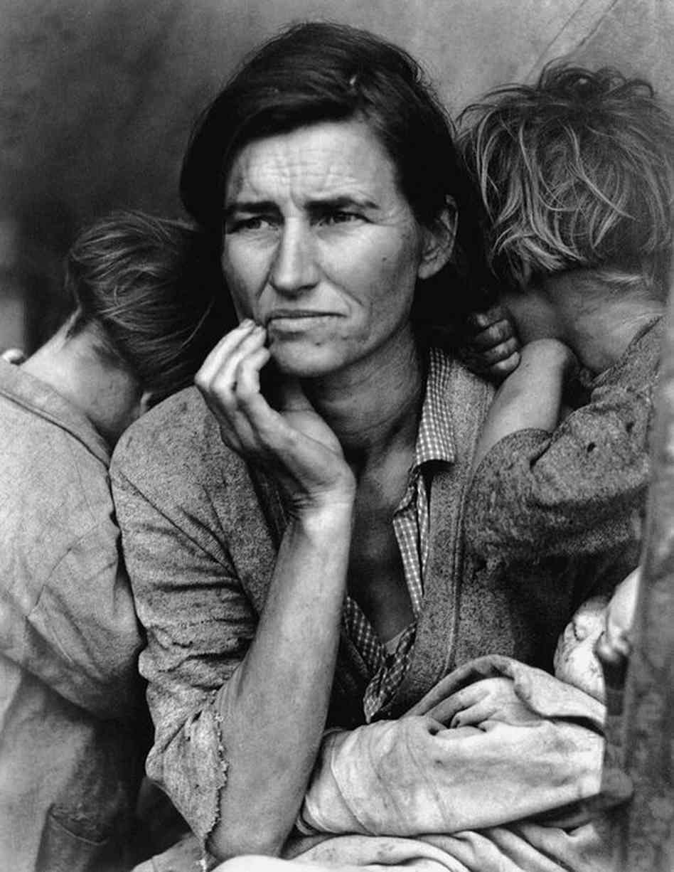
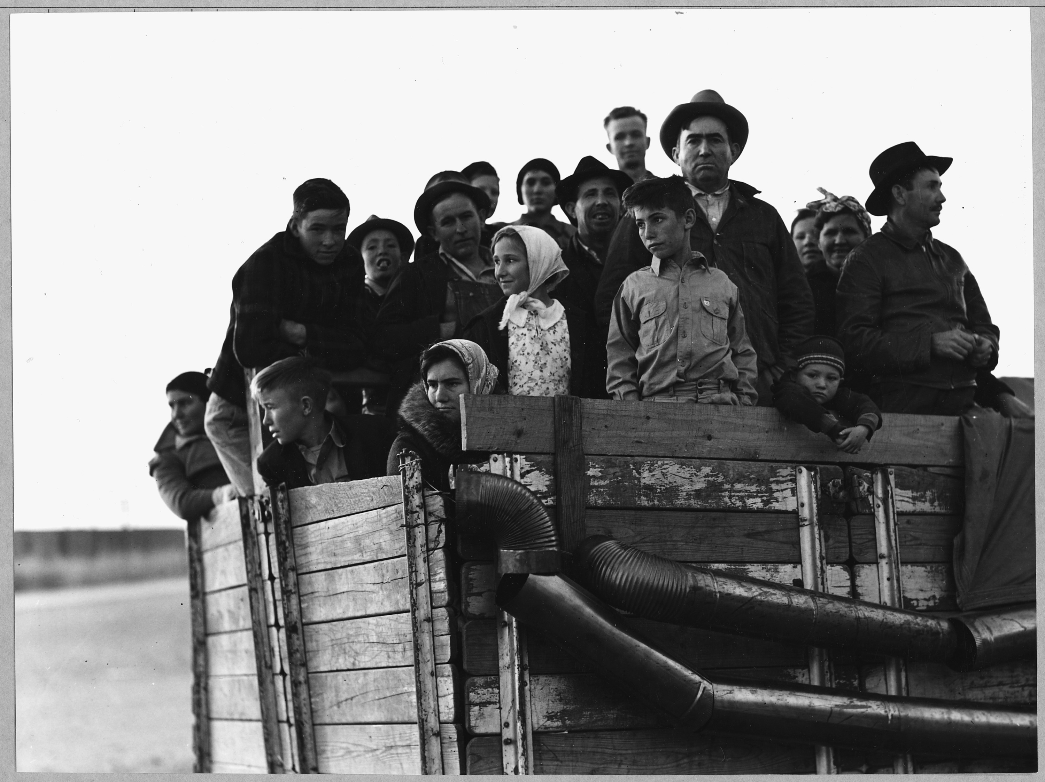

Slide 10
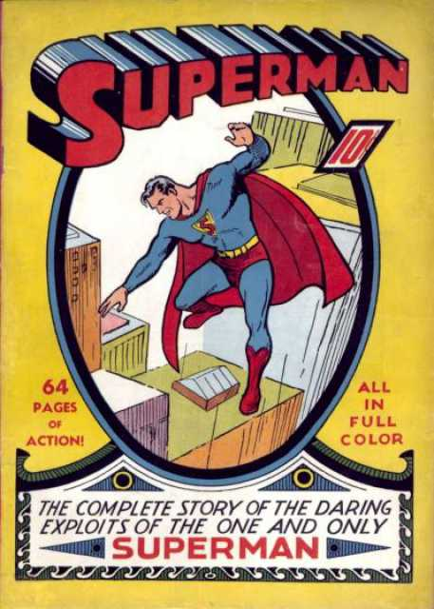
Literature of the Depression
Many of the novels from the depression era featured blue-collar, working-class heroes
In John Steinbeck’s The Grapes of Wrath, the struggles of the fictional Joad family are detailed from their home in Dust Bowl era Oklahoma to the farms in California
Lillian Hellman, a New Orleans native and a playwright, wrote several influential plays of the era
Americans were first exposed to the lighter tones of comic strips and comic books, like Dick Tracy and Superman

