Slide 1
Domestic Policy in the 1950s & 1960s

Slide 2
Warren Court Reforms

Slide 3
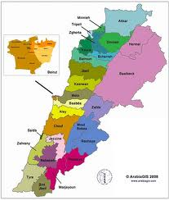
“One Man, One Vote”
Reapportionment → the way in which states draw up political districts based on population
States failed to change their political districts after the urbanization of America
Reynolds v. Sims (1964) → the current apportionment system in most states was unconstitutional
Warren Court required states to reapportion electoral districts so they every person was equally represented

Slide 4
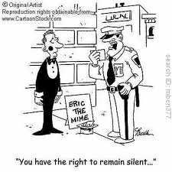
Extending Due Process
Due Process → the law may not individuals unfairly, arbitrarily, or unreasonably, and that courts must follow proper procedures when trying cases
Mapp v. Ohio (1961) → state courts could not consider evidence obtained in violation of the federal Constitution
Gideon v. Wainwright (1963) → a defendant in a state court had the right to a lawyer, regardless of his or her ability to pay
Miranda v. Arizona (1966) → required all authorities to immediately inform suspects that they the right to remain silent, that anything they say can and will be used against them in a court of law; that they have the right to a lawyer, and if they can’t afford one, one will be provided for them
Known as Miranda Rights today

Slide 5
Prayer and Privacy
Engel v. Vitale (1962) → that could not compose official prayers and require those prayers to be recited in public schools
Abington School District v. Schempp (1963) → ruled against state-mandated Bible readings in public schools
Griswold v. Connecticut (1965) → ruled that prohibiting the sale and use of birth control violated citizens’ constitutional right to privacy

Slide 6
The Great Society

Slide 7
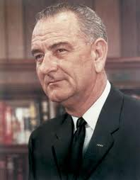
War on Poverty
After his election, Johnson began working with Congress to create “The Great Society”
Johnson wanted aid the poor and to build a better society “where leisure is a welcome chance to build and reflect… where the city of man serves not only the needs of the body and the demands of commerce but the desire for beauty and the hunger for community”

Slide 8
Great Society Programs
Medicare → medical coverage and care for senior citizens with no health insurance
Funded through social security
Medicaid → financed health care for welfare recipients living below the poverty line
Head Start → directed at disadvantaged children who had “never looked at a picture book or with a crayon”

Slide 9
Great Society Programs
Upward Bound → designed to prepare low-income teenagers for college
Department of Housing and Urban Development → authorized subsidies to areas that lacked sufficient or affordable housing
Immigration Act of 1965 → eliminated the national origins system established in the 1920s, which gave preferential treatment to immigrants of northern European origin

Slide 10
Great Society’s Legacy
Programs still available today: Medicare, Medicaid, Department of Housing and Urban Development (HUD), and Project Head Start
Left many questions:
“How can the federal government help disadvantaged citizens?
How much government help can a society provide without weakening the private sector?
How much help can people receive without losing motivation to fight against hardships on their own?

