Slide 1
Emergence of a New Mass Culture

Slide 2
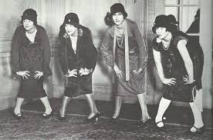
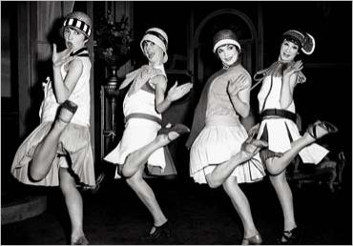
More Leisure Time Available
The average work week in cities fell from 70 hours in 1910 to 45 in 1930
People now worked five days a week instead of seven, allowing for more free time
Salaries were also steadily increasing for most Americans throughout the 1920s

Slide 3
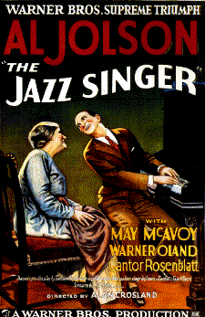
Americans Flock to the Movies
Motion pictures became a new favorite past time for Americans
A small number of huge studios in Hollywood established a monopoly that controlled the production, distribution, and exhibition of movies
For most of the decade, films were silent, with a live musician providing sound in the theater
In 1927, The Jazz Singer was released as the first film with synchronized sound
Sound films, known as “talkies” replaced silent films as the mainstream movies

Slide 4
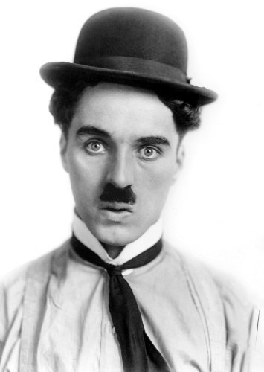
Famous Actors of the Era
Charlie Chaplin → most popular silent film star; portrayed the Little Tramp, a hobo and eternal optimist that delighted viewers across the nations
Rudolph Valentino → Italian born actor who portrayed many romantic leads
William S. Hart → often portrayed cowboys who worked to maintain law and order

Slide 5
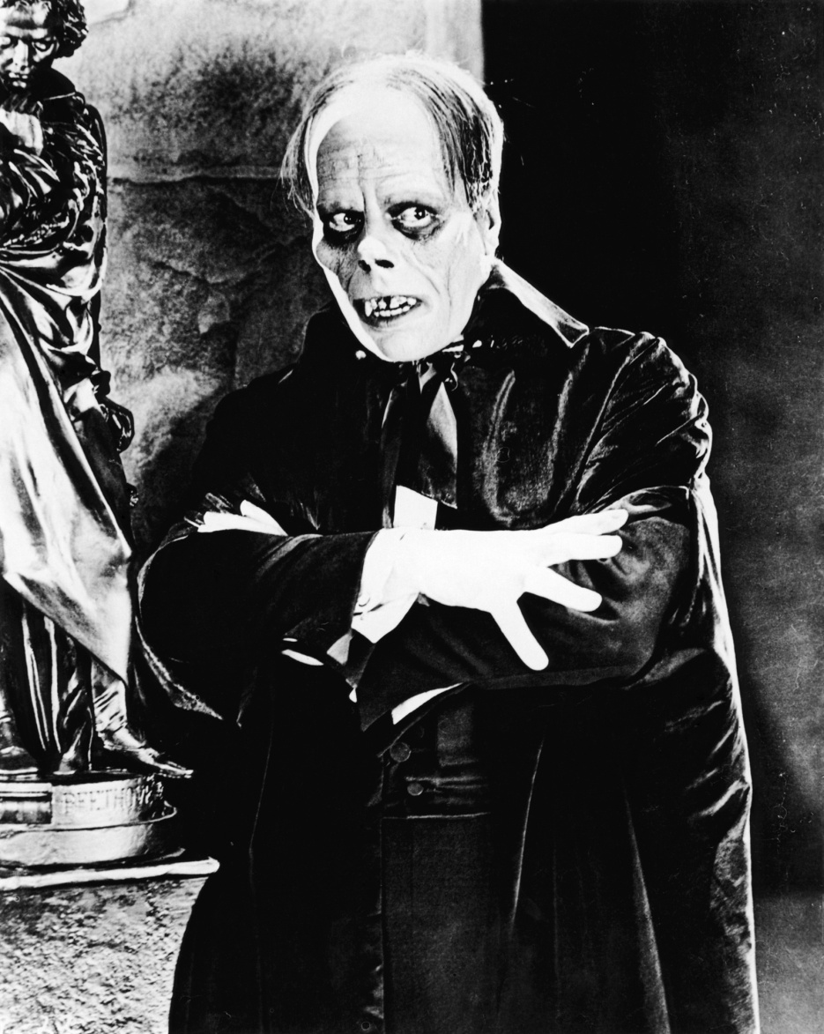
Famous Actors of the Era
Mary Pickford → known as “America’s Sweetheart”
Lon Chaney → star of horror films, such as the Phantom of the Opera and the Hunchback of Notre Dame
Douglas Fairbanks → Atheltic star of many action movies such as Robin Hood

Slide 6
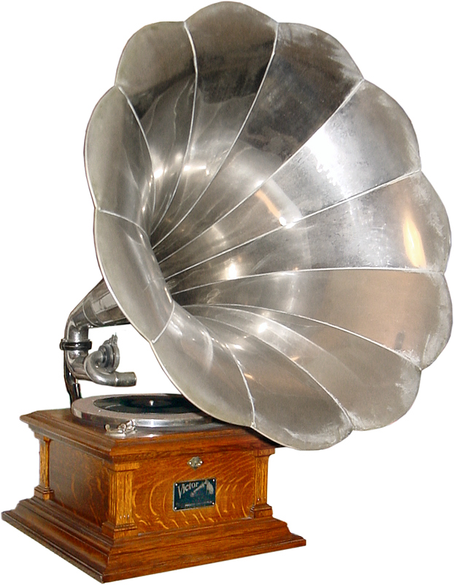
Radio and Phonograph Break Barriers
The phonograph and radio helped to standardize culture, making it easy for residents of the North, South, East, and West to all hear the same songs, learn the same dances, and share the same popular culture
In 1920, an executive of the Westinghouse company started a radio station, KDKA, in Pittsburgh, PA
Within three years there were 600 licensed stations broadcasting to 600,000 radio sets

Slide 7
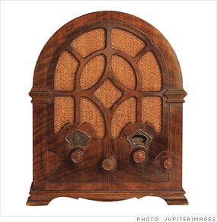
Radio and Phonograph Break Barriers
Americans tuned in to hear religious sermons, news and weather reports, popular music, educational lectures, sporting events, and more
In 1927, millions of Americans listened to the boxing match between Gene Tunney and Jack Dempsey
The phonograph (like a modern record player) allowed people to listen to the music of their choice at their leisure

Slide 8
The Charleston Music and Dance
The Charleston

Slide 9
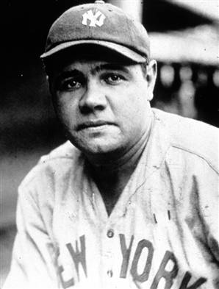
Pop Culture Creates Heroes
The 1920s became known as the Golden Age of Sports due to the large number of famous athletes
Babe Ruth → baseball player for the New York Yankees and Boston Red Sox that became a homerun legend
Red Grange → football star
Jack Dempsey → boxing champion
Bobby Jones → golf legend
Bill Tilden → excelled in tennis
Gertrude Ederle → first woman to swim the English Channel

Slide 10
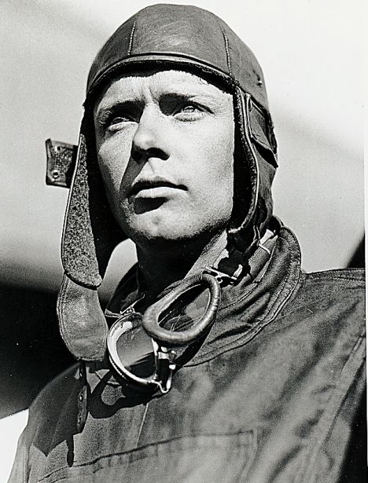
Charles Lindbergh Inspires the Nation
In the 1920s, the airline industry was very new, although flying “aces” played a vital role in WWI
In May, 1927, Charles Lindbergh flew his plane, The Spirit of St. Louis, from New York to Paris, France in the first solo, non-stop flight
Lindbergh faced personal tragedy when his son was kidnapped and later murdered

Slide 11
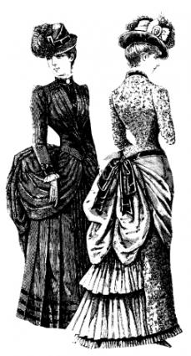
Flappers Challenge the Traditional Past
During the Victorian Age of the late 19th and early 20th century, women had been expected to center their lives on the home and family
Fashion from this era was also very concealing, including long skirts, long sleeves, and high necklines
The New Woman of the 1920s was more liberated, wearing shorter hemlines, more makeup, dancing to the latest craze, and expecting to be treated equally to men

Slide 12
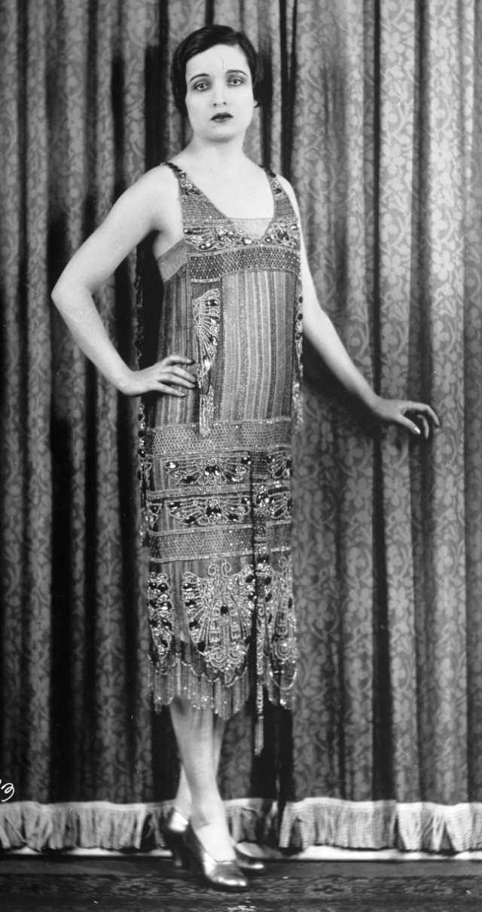
Flappers Challenge the Traditional Past
Flapper → a young woman with short skirts and rouged cheeks who had her hair cropped close in a style known as a bob
However, even with all the changes, the Victorian sense of morality and separate spheres of men and women still existed

Slide 13
Women Make Political Strides
The fight for women’s suffrage was won in 1920 with the passage of the 19th Amendment
The National American Woman Suffrage Association then called on women to work in reform movements, run for office, or fight for laws to protect women and children in the workplace
The National Women’s Party demanded complete economic, social, and political equality with men
Women will eventually began to move into jobs such as sales, journalism, banking, and the medical field

Slide 14
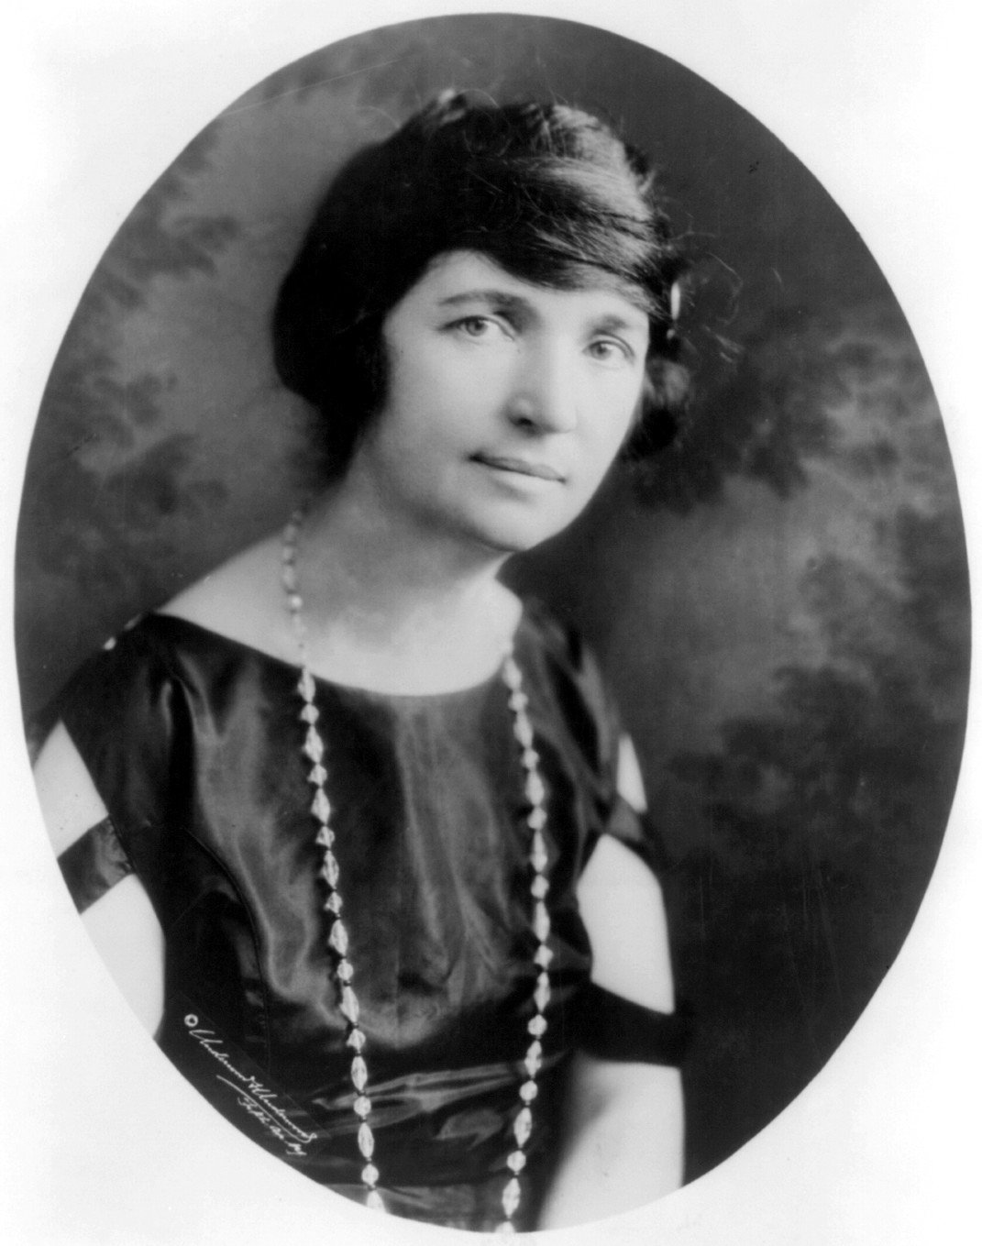
Changing Family Life
During the 1920s, women tended to live longer, marry later, and have fewer children
Smaller families were made possible partially due to the improvements in birth control by Margaret Sanger (founded of the American Birth Control League – Planned Parenthood)
The new consumer economy introduced vacuum cleaners, irons, and other electric devices

Slide 15
Art Reflects Social Uncertainty
During the Victorian era, most authors expressed a positive belief in progress
Following WWI, authors began to question this notion
A new generation of authors argued that the war had displayed an irrational exploit of civilization without a sense of direction
The theories of Sigmund Freud argued that much of human behavior is driven by unconscious desires and that people must learn to suppress these desires

Slide 16
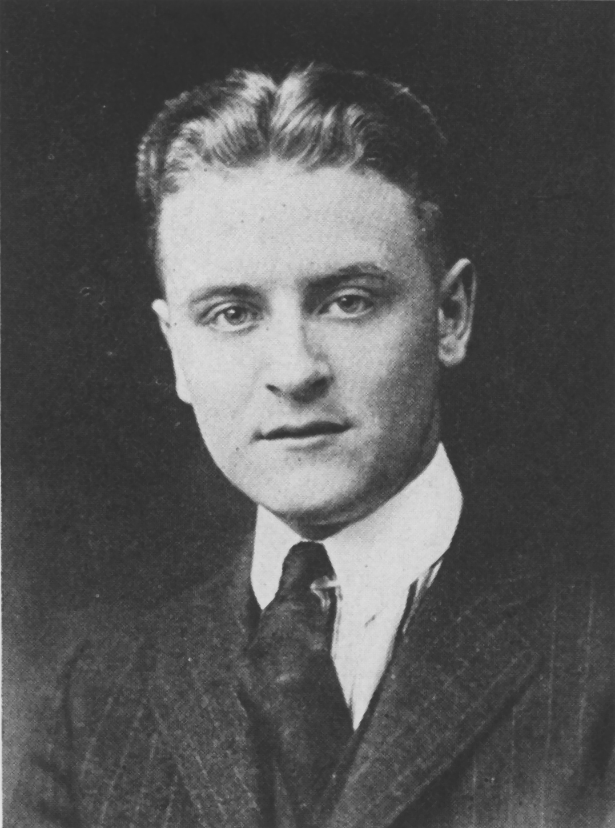
Postwar Literature Flourishes
“Lost Generation” → the name coined by Gertrude Stein for the American writers of the 1920s who no longer had faith in the cultural standards of the Victorian age
These authors began to look for new truths and fresh ways of expressing those truths
F. Scott Fitzgerald explored the reality of the American dream of wealth, success, and emotional fulfillment

Slide 17
American Postwar Novelists
Novelist | Major Themes | Representative Work
Willa Cather (1873-1947) | Frontier life on the Great Plains | My Antonia (1918) depicts the passing of the American frontier through the life of an immigrant girl in Nebraska
William Faulkner (1897-1962) | Life in the South; inner workings of the mind | The Sound and the Fury (1929) uses different narrators to tell the story of the complex inner workings of a Southern family
F. Scott Fitzgerald (1896-1940) | The Jazz Age | The Great Gatsby (1925) shows the emptiness of the Jazz-Age world of flappers and bootleggers
Ernest Hemingway (1899-1961) | Disillusionment of postwar generation | A Farewell to Arms (1929) tells the story of doomed love between a cynical American ambulance driver and a nurse during WWI
Sinclair Lewis (1885-1951) | Small-town life in the Midwest | Main Street (1920) paints a satirical portrait of small-minded people in an American town
Edith Wharton (1862-1937) | Life among the rich in New York | The Age of Innocence (1920) depicts a wealthy young man prevented by social conventions from marrying the woman he loves

Slide 18
Modern Painting Challenges Tradition
Modernism clashed with traditionalism once again in modern art
Artists began to move away from representational paintings that simply reproduced life and experimented with more abstract styles
Paintings by Georgia O’Keeffe became very popular

