Slide 1
New American Diplomacy

Slide 2
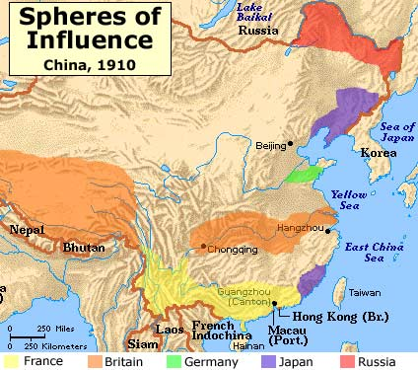
Open Door Policy
1894 → War erupts between China and Japan over Korea
Japan easily defeats China and grants Korea their independence and gained territory in Manchuria
Russia did not like this, so together with Germany and France forced Japan out and made China lease the territory to Russia
Became a “sphere of influence” → an area in which a foreign nation controlled economic developments

Slide 3
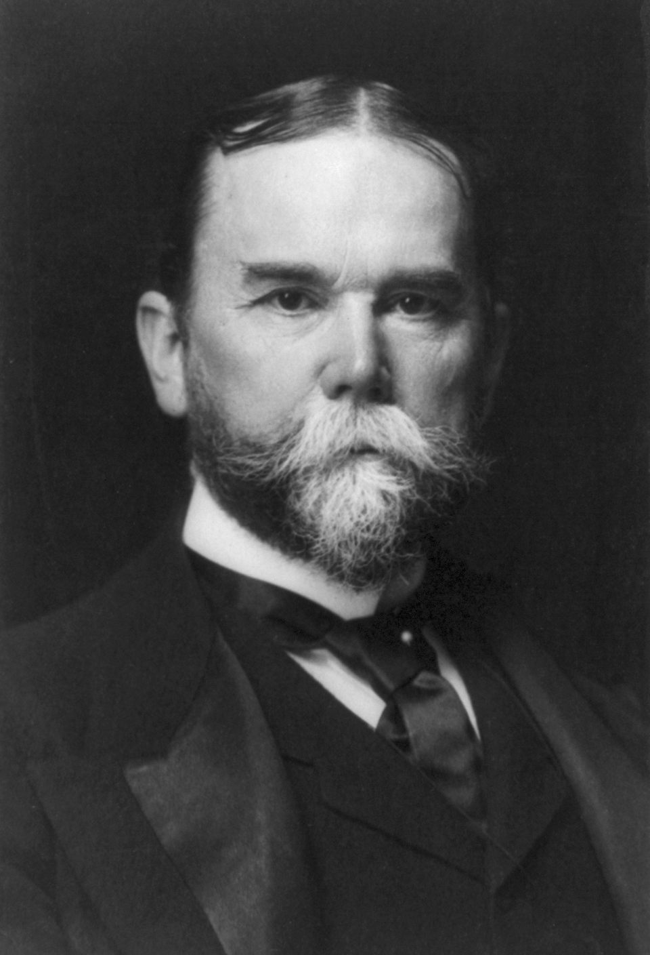
Open Door Policy
President McKinley and Secretary of State John Hay supported an “open door policy”
All countries would be allowed to trade with China
Hay sent notes to all of the countries with leaseholds in China to persuade them to agree to the Open Door Policy
They agreed as long as ALL of the countries agreed to it as well

Slide 4
Boxer Rebellion
Secret Chinese societies organized with the increasing influence of foreign nations
The Society of the Harmonious Fists (Boxers)
1900 → Boxers decided to destroy the “foreign devils” and all of the Christian converts in China
Boxers, supported by some Chinese troops attacked foreign embassies, killed over 200 foreigners, and took many prisoners
Germany, Austria-Hungary, Britain, France, Italy, Japan, Russia, and the United States sent in 50,000 troops to put down the rebellion
John Hay worked to convince foreign nations not to break up China into colonies, and instead accept compensation for damages from the rebellion
United States retained access to one of the most lucrative markets in the world

Slide 5
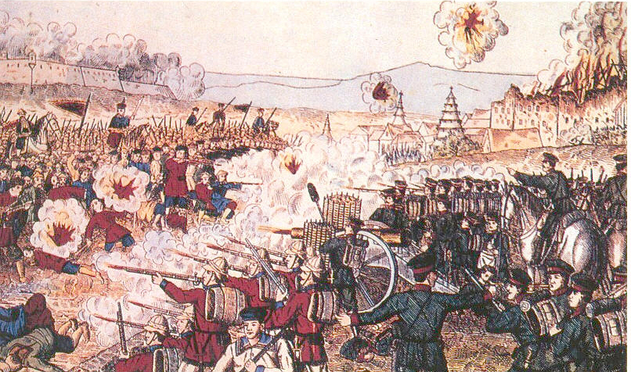

Slide 6
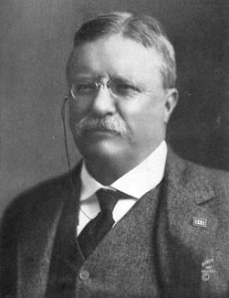
Roosevelt’s Diplomacy
McKinley chose Theodore Roosevelt (the hero of San Juan Hill) as his running mate
Focused on growing American prosperity
September 6, 1901 →McKinley is assassinated in Buffalo, NY by Leon Czolgosz, an anarchist
Roosevelt, at 42, was the youngest person to become president
“Now look that… cowboy is president of the United States!” – senator Mark Hanna
Believed in increasing American influence around the world and in Anglo-Saxonism

Slide 7
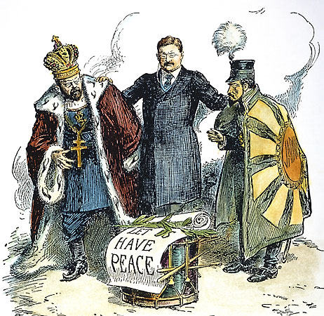
Balancing Power in East Asia
Roosevelt supported the Open Door Policy and wanted to stop any nation from completely taking over trade in China
Roosevelt helped negotiate an end to the Russo-Japanese War in 1905
Convinced Russians to recognize Japan’s territorial gains and persuaded the Japanese to stop fighting for more territory
Earned the Nobel Peace Prize in 1906
Relations between Japan and the United States grew worse over time as they both wanted influence in China

Slide 8
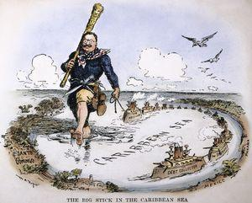
Panama Canal
Roosevelt believed that displaying American military power would discourage other nations from fighting and promote peace
“Speak softly and carry a big stick”
1901 → Hay-Pauncefort Treaty, gave the United States the exclusive right to build any proposed canal through Central America
A French company had attempted a canal in Panama in 1881, but gave up eight years later because of bankruptcy and disease

Slide 9
Panama Canal
US considered two possible sites for the canal → Nicaragua and Panama
French company offered to sell its rights in Panama to the United States
1903 → United States offers Colombia $10 million and a yearly rent of $250,000 for the right to construct a canal
Colombian government refused the offer

Slide 10
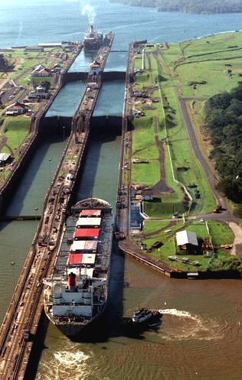
Panama Canal
Panamanians feared lost of commercial benefits of the canal
French company feared the United States would build in Nicaragua instead
November 3, 1903 → Panamanians revolted with France support
United States recognized Panama’s independence
Roosevelt claimed that he had advanced “the needs of collective civilization” by shortening the distance between the Atlantic and Pacific by 8,000 nautical miles

Slide 11
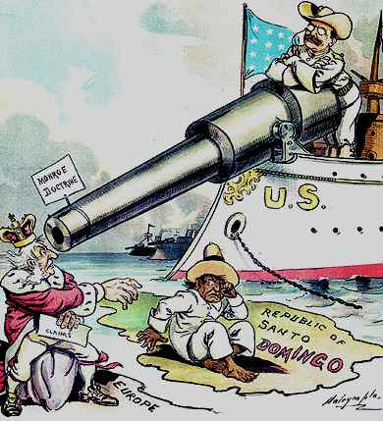
Roosevelt Corollary
United States became concerned when Venezuela defaulted on European loans and Britain, Germany, and Italy blockaded its ports
Roosevelt gave a speech known as the Roosevelt Corollary to the Monroe Doctrine
United States would intervene in Latin American affairs when necessary to maintain economic and political stability in the Western Hemisphere
Goal: Prevent European nations from using debts as a justification for intervening in the region

Slide 12
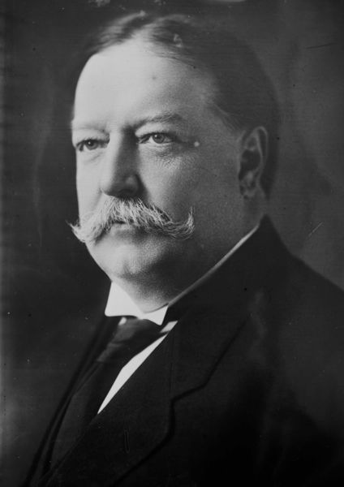
Dollar Diplomacy
William Howard Taft, the next president, continued Roosevelt’s policies in Latin America
Believed that if American business leaders support Lain American development, everyone would benefit
Dollar Diplomacy → American businesses would increase their trade and profits, and countries in Latin America would rise out of poverty and social disorder

Slide 13
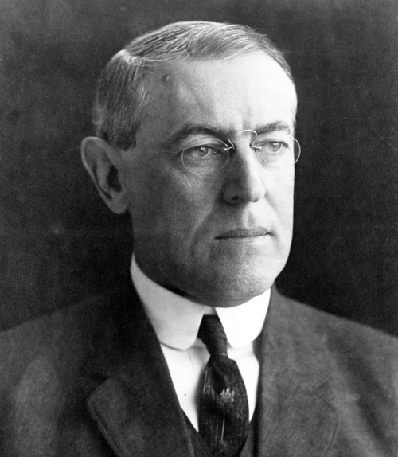
Woodrow Wilson’s Diplomacy in Mexico
Wilson was more comfortable dealing with domestic policy, but his presidency would be marked with international affairs
Opposed imperialism and wanted to end the “nationalist self-seeking in American foreign policy”
Believed that the world would be free of revolution and war by promoting democracy

Slide 14
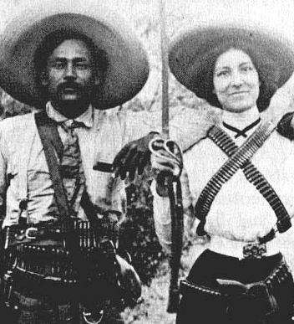
Mexican Revolution
Porfirio Dìaz ruled Mexico as a dictator
Promoted industrialization of Mexico, but mostly foreign nations owned and financed the railroads and factories
1911→ Francisco Madero, a reformer who supported democracy, constitutional government, and land reform, led the revolution
Not an effective leader
February, 1913→ General Victoriano Huerta gained control
Wilson refused to recognize Huerta, believing that without US support, he would be overthrown

Slide 15
Wilson Sends Troops into Mexico
April 1914 → American sailors are arrested for entering a restricted area
Quickly released but US demands an apology; Mexico refuses
Wilson asks Congress for the rest to use force and shortly learned that a German ship was bringing weapons to Mexico
Wilson orders the bombing of the Mexican harbor
Anti-American riots break out in Mexico
Wilson agrees to mediation to end conflict
Venustiano Carranza becomes president of Mexico

Slide 16
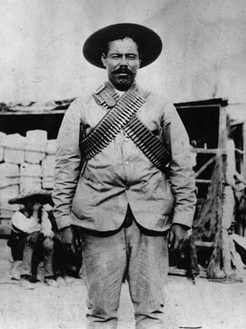
Wilson Sends Troops into Mexico
March 1916 → Pancho Villa and a group of guerillas burned the of Columbus, New Mexico and killed 16 Americans
Wilson responded by ordering 6,000 troops under General John J. Pershing into Mexico to find Villa
They had no luck and were recalled in 1917

