Slide 1
The Harlem Renaissance

Slide 2
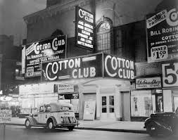
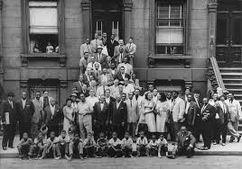
The Harlem Renaissance
African American culture began to flourish in the 1920s, especially in Harlem, a subsection of Manhattan, in New York City
This era of change and growth is referred to as the Harlem Renaissance
The Harlem Renaissance helped give a new vocabulary and dynamic to race relations in the United States

Slide 3
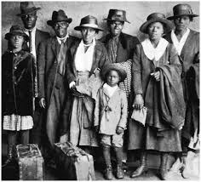
Migrants Face Challenges and Experience Chances
Wages in northern cities were far better than want a sharecropper could earn in the South
African Americans also started to experience a growing political voice in the North
There was a growing middle and upper class of blacks in those cities

Slide 4
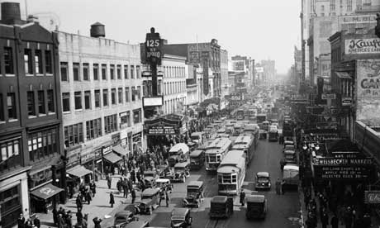
Migrants Face Challenges and Experience Chances
However, the North still displayed plenty of discrimination and oppression
They were forced to take the worst housing and received the lowest wages
New York City’s Harlem became a focal point for the aspirations of hundreds of thousands of blacks

Slide 5
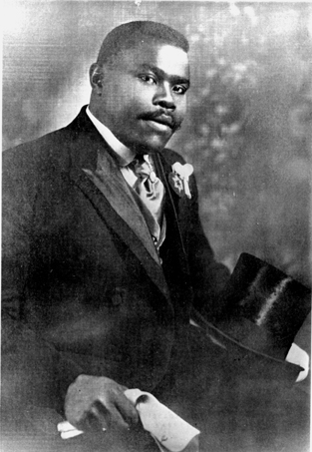
Garvey Calls for Racial Pride
Marcus Garvey, born in Jamaica, travelled widely before immigrating to the United States in 1916
He observed that blacks were exploited all around the world
He promoted the idea of universal black nationalism and organized a “back to Africa” movement
Garvey advocated a separation of the races, unlike Du Bois and Washington
By the mid-1920s his Universal Negro Improvement Association had almost 2.5 million members and sympathizers
Eventually his movement fell apart when he was jailed for mail fraud and deported to Jamaica

Slide 6
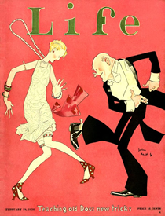
The Jazz Age
The term “jazz age” was coined by F. Scott Fitzgerald and refers to the changing culture of the 1920s
However, jazz itself was created by African American musicians
Jazz is a musical form based on improvisation, combining elements from blues, ragtime, and European-based popular music
First emerged in the South, particularly New Orleans, and followed African Americans north in the Great Migration

Slide 7
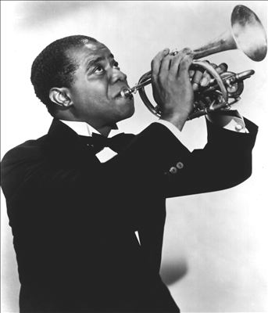
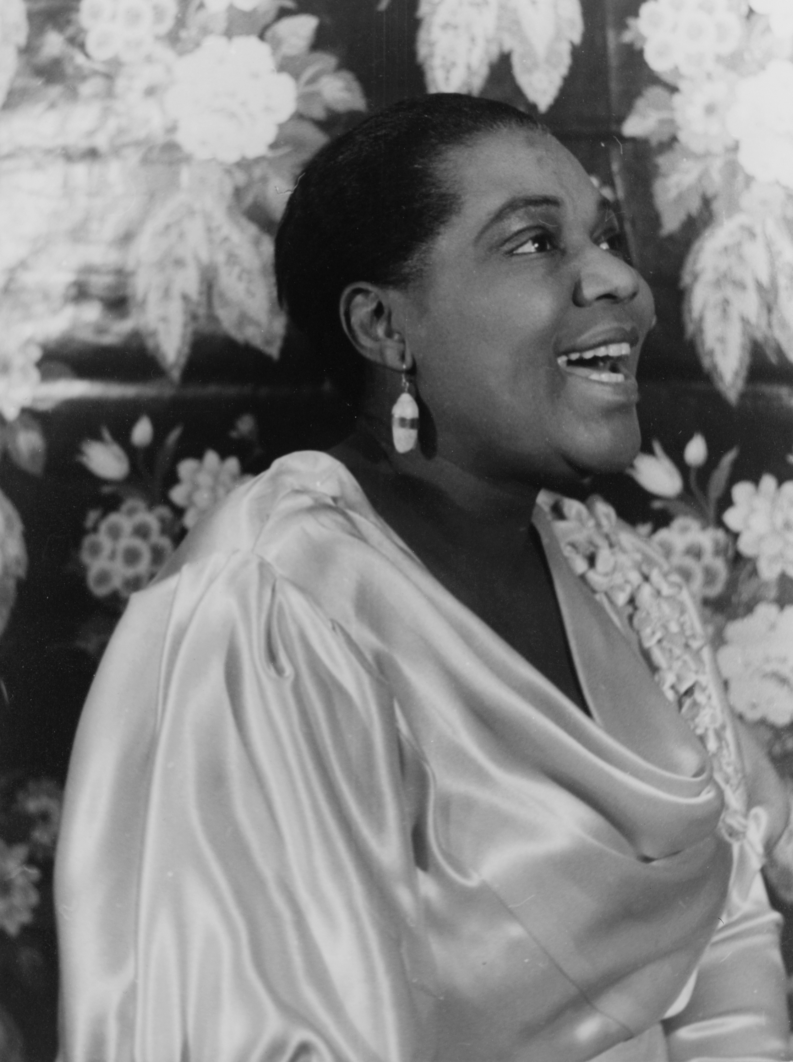
Jazz Gains Popularity
Louis Armstrong became the unofficial leader of the jazz movement with his masterful playing of the trumpet and subtle sense of improvisation
Bessie Smith became a very popular female jazz vocalist who earned the nickname “Empress of the Blues”
Jazz was played in speakeasies all over the country, eventually gaining popularity all over the world

Slide 8
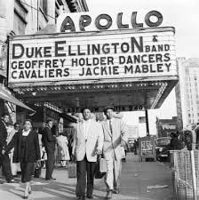
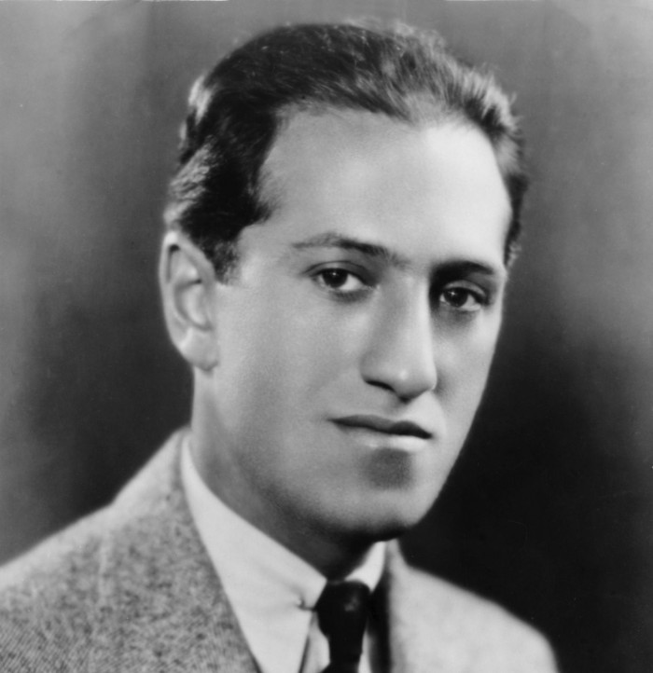
Jazz Gains Popularity
Duke Ellington coined the term “swing” in his hit song “It Don’t Mean a Thing if it Ain’t Got that Swing”
Jazz began to bridge the gap between the races with success from white jazz musicians George Gershwin, Cole Porter, and Irving Berlin

Slide 9
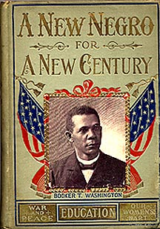
African American Literature
In the 1920s, the term “New Negro” emerged suggesting a radical break with the past
No longer with African Americans silently endure the old ways of exploitation and discrimination
African American novelists, essayists, poets, and journalists became attracted to this new attitude in Harlem

Slide 10
African American Literature
Jean Toomer’s Cane (1923), a collection of short stories, poems, and sketches, set the tone for the Harlem Renaissance with its presentation of African American culture
Claude McKay, a Jamaican immigrant, became a leader in African American literature with his novels and poems which showed ordinary black Americans struggling for dignity and advancement

Slide 11
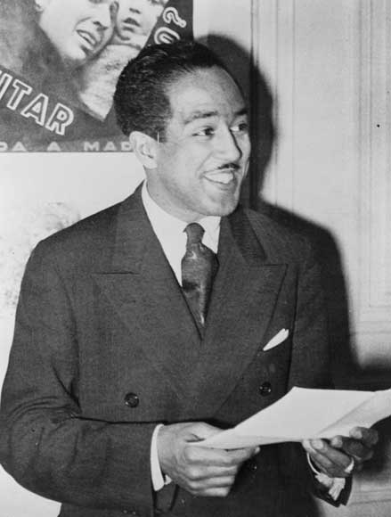
African American Literature
Langston Hughes was one of the most powerful voices of the Harlem Renaissance
For Hughes, the movement was not political, but instead was a celebration of African American culture and life
Hughes published more than 50 works in which he captured the remarkable diversity of everyday African American life
Zora Neale Hurston traveled the rural back roads for her native Florida, collecting folk tales
Her 1937 novel, Their Eyes Were Watching God, expressed the new longing for independence felt by many women of the 1920s

Slide 12
Dreams – Langston Hughes
Hold fast to dreams
For if dreams die
Life is a broken-winged bird
That cannot fly.
Hold fast to dreams
For when dreams go
Life is a barren field
Frozen with snow.

Slide 13
Harlem (Dreams Deferred)
What happens to a dream deferred?
Does it dry up
like a raisin in the sun?
Or fester like a sore—
And then run?
Does it stink like rotten meat?
Or crust and sugar over—
like a syrupy sweet?
Maybe it just sags
like a heavy load.
Or does it explode?

Slide 14
Their Eyes Were Watching God
Ships at a distance have every man’s wish on board. For some they come in with the tide. For others they sail forever on the horizon, never out of sight, never landing until the Watcher turns his eyes away in resignation, his dreams mocked to death by Time. That is the life of men. Now, women forget all those things they don’t want to remember, and remember everything they don’t want to forget. The dream is the truth. Then they act and do things accordingly.

Slide 15
Lasting Impact of the Harlem Renaissance
The Harlem Renaissance gave a voice to African Americans that was never seen before
It altered the way many white Americans viewed African American culture
The Harlem Renaissance ended with the national financial collapse and also ended the nation’s decade of prosperity
However, the sense of identity created continued to grow throughout the entirety of the 20th century, becoming the foundation of the civil rights movement

